Slide 1
OER Policy Clinic for Foundational Literacy and Numeracy
In partnership with the EdTech Hub, UNESCO, the mEducation Alliance, and the Education Commission
Neil Butcher
27/09/2021

Slide 2
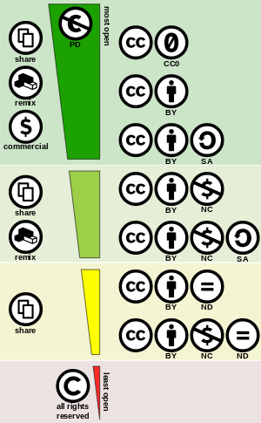
OERs are teaching, learning, and research resources that reside in the public domain or have been released under an intellectual property licence that permits their free use and repurposing by others.
Creative Commons licences permit the copyright owner to determine the extent to which others are legally allowed to reuse material.
Educational content can adopt licences to suit specific uses.

Slide 3
The growing imperative for openness
COVID-19 pandemic has revealed clear fault lines in current education systems and accelerated the imperative for change – problems include:
Rigid, over-structured, out-of-date curricula and excessive summative assessments that close spaces for real learning
Growing inequalities in access, further closing opportunities for learning
Dehumanization of educators through ‘micro-managing’ HR policies
Rigid, over-elaborated policies that show little resilience in the face of crisis or change
Acceleration of global problems (pandemic, climate change, food security, shifting employment due to 4IR, etc) requires international cooperation (supported by open knowledge networks) but there are growing signs of isolation and closure

Slide 4
‘OER policies’ provide no guarantee of openness
Open licensing is not, by itself, a meaningful proxy for openness in education (improved access, better quality, greater success after studies, more flexibility, etc)
Open licensing can just as easily be deployed to entrench rigid, closed systems of education as it can help to create more open learning
Every policy decision we make should be measured against its real transformative effects on education

Slide 5
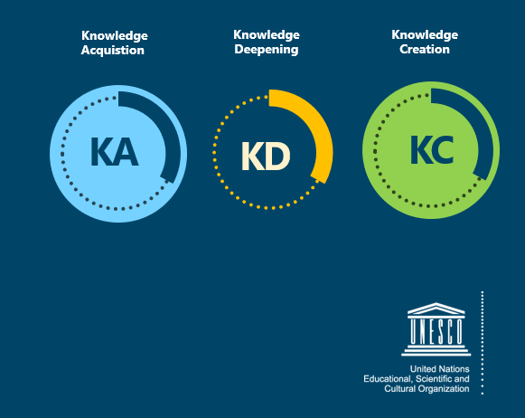
TPD – UNESCO ICT Competency Framework for Teachers (CFT)
Tool to guide pre- and in-service teacher training on ICT in education (CC BY)
Resources to teach educators to use OERs and create their own openly licensed content available on ICT CFT Hub
Adapted for use in multiple countries at national level
Available in English, Arabic, French

Slide 6
TPD – Teacher Education in Sub-Saharan Africa (TESSA)
OER linked to school curricula
Supports teachers develop active approach to learning
Adapted to 10 countries and available in 4 languages
Used in schools and national institutions
Handbooks for teachers, training materials, activities
Used by pre-service and in-service teachers
Download for offline use

Slide 7
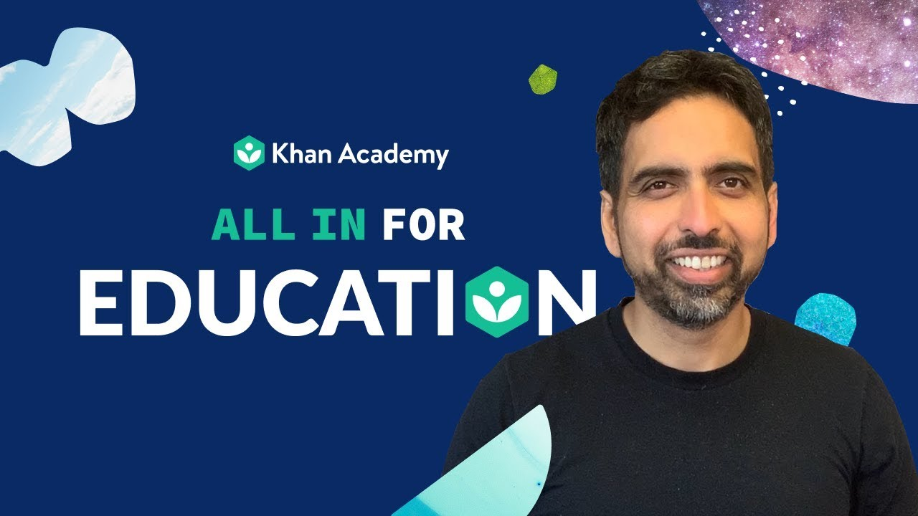
Personalized learning – Khan Academy
‘Mastery learning’ – let learners go at their own pace
Aligned to Common Core standards
Supports face-to-face and distance learning and teaching
Skills reports to monitor learner progress
High-quality, free education to anyone, anywhere, in 26 languages
‘All Khan Academy content is available for free at www.khanacademy.org’

Slide 8
Some examples of open licences for literacy
StoryWeaver and African Storybook
Bloom Digital Library
Book Dash
Global Digital Library (CC BY and CC BY-SA)
Molteno Vula Bula – graded readers
Ubongo – multimedia content

Slide 9
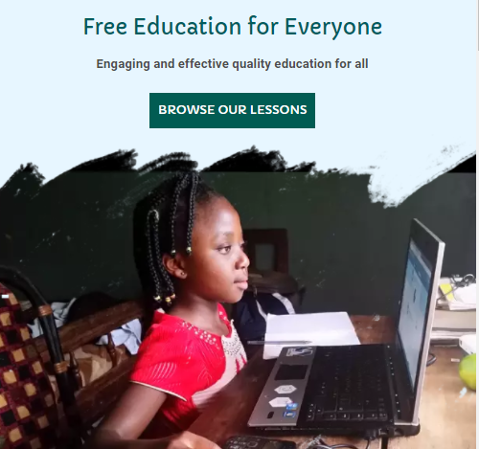
Personalized learning - Oppia
Open source tech platform ‘to make it easy for anyone to create online interactive activities’
Online learning – story-based lessons, low bandwidth, translations, tailored feedback
Teachers and content creators can add content and adapt/translate other user-generated content

Slide 10
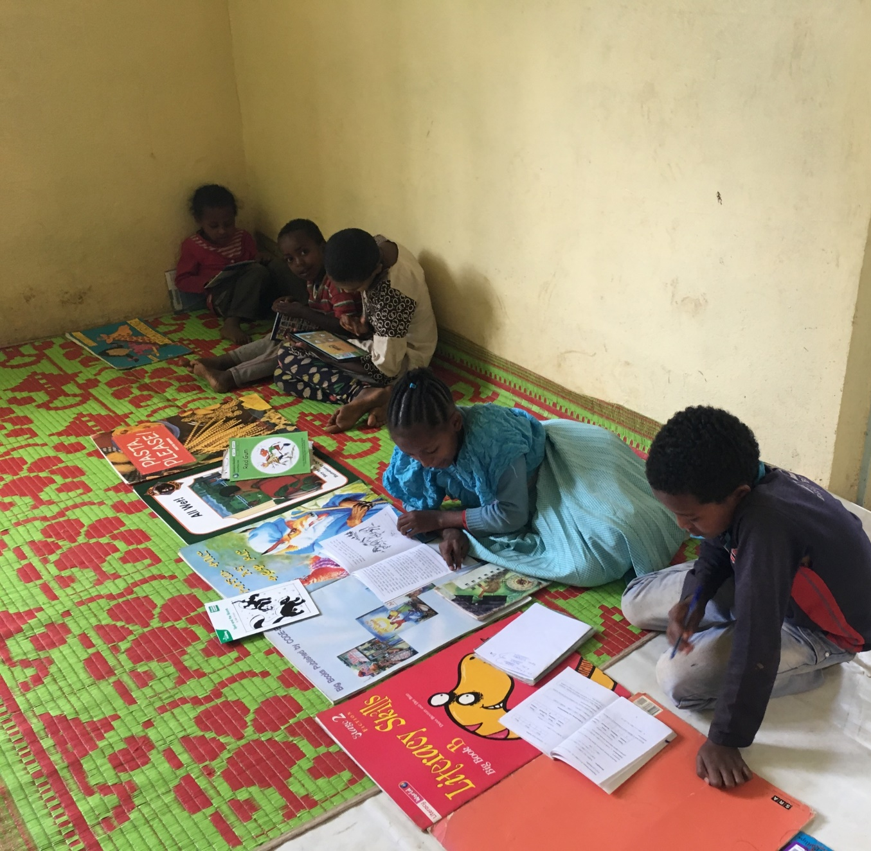
What OER initiatives are taking place at national or institutional level in your country or region?
What needs to be done to scale up and sustain these initiatives?

Slide 11
Policy changes to make effective use of OER
Review existing educational policies and regulations to assess the extent to which they support openness and/or impede implementation of OER and the UNESCO OER Recommendation
Consider the possibility of policy change including the removal and/or radical simplification of existing policies – and not just about adding new policies
Ensure that considerations of openness are reflected in development of new policies and regulations affecting education, including those devised as part of the adaptation of education provision in response to COVID-19
Ensure that processes focus attention first on the wellbeing and empowerment of educators as full-functioning adults who are entrusted with the role of educating for the future – no meaningful openness is possible where policies dehumanize educators

Slide 12
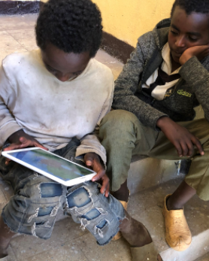
What are the main barriers to effective OER use in your countries?
What examples do you know of where policy supports or encourages effective OER use?
What policies should we consider: educational practice, intellectual property, learning and teaching materials, procurement, human resource development, etc?
Policies can be restrictive, complicated, creating closure, not openness: How can we simplify and ‘declutter’ policy?
Do we need integrated or standalone policies?

Slide 13
What cost factors need to be considered?
Policy, strategies, and planning
Training and capacity building
Technology and infrastructure
Creation, translation, and adaptation of high-quality resources
Uploading and hosting resources
Management and curation of OERs

Slide 14
Monitoring effectiveness
Governments can monitor some key indicators over time to evaluate the effectiveness of policy for implementing the use of OER.
Rating of the extent to which educational resources developed with public funds are available as OER
Rating of the extent to which policy and legal frameworks promoting OER use in support of educational outcomes include incentives for stakeholders to use/re-use OER
Rating of the extent to which policy and legal frameworks enable procurement of OER-related
Rating of the extent to which OER are available in all national languages
Rating of the extent to which OER have been contextualized for local social, economic and cultural contexts
Do you have suggestions for monitoring policy effectiveness?

Slide 15
Questions for discussion
What do you anticipate doing next in your countries?
What skills, knowledge or capacity building is required to create policy that supports open education practices?
How can policy be simplified to make education systems more ‘open’?
How can we keep this conversation going?
How can we support you?

Slide 16
Additional resources - UNESCO Recommendation on OER and Dynamic Coalition - Working draft: Possible Actions to Operationalize the UNESCO OER Recommendation - UNESCO ICT Competency Framework for Teachers - Case Study on Open Licensing of Early Grade Textbooks in Uganda - The Impact of Open Licensing on the Early Reader Ecosystem - Open Licensing Made Plain: A Primer on Concepts, Challenges, and Opportunities for Publishers - Good Stories Don't Grow on Trees: A Guide to Effective Costing of Storybooks in the Global South - Closed or open? Ubongo’s switch from copyright protected to Creative Commons licensing Follow NBA for more info: www.nba.co.za | LinkedIn | Twitter

