Slide 1


UNESCO ICT-CFT & OER
3rd February 2021
Knowledge
Acquistion
Knowledge
Deepening
Knowledge
Creation
Leveraging advantage from existing OER in the creation of teacher professional development courses
Prepared by Neil Butcher & Associates

Slide 2
Problem statement
How do we get teachers to integrate ICT effectively into teaching and learning, and
into their other administrative duties?

Slide 3

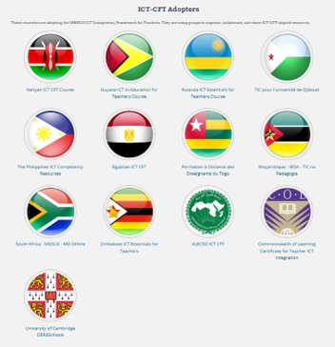
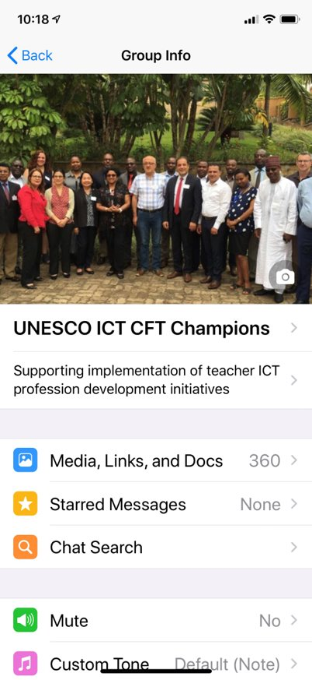
1
2
3
Teacher ICT
Competency Framework
Repository of aligned OER to build teacher training courses
Community of
experienced practitioners

Slide 4





OER in Action │ UNESCO ICT CFT Courses Timeline
Guyana (2010 –2012)
Course name: ICT in Education Teachers Course Audience: In-service and pre-service teachers Developer: National Centre for Education Resource Development (NCERD) Methodology & distribution mechanism: Facilitated - paper based / CD - DVD
English
Guyana
Ratio of
ICT-CFT Approaches
Creative Commons
Licence
http://colccti.colfinder.org/sites/default/files/guyana/index.html
Notes:
OER were collected and compiled to create the Guyana ICT in Education Teachers Course, by National Centre for Education Resource Development (NCERD) to support the implementation of a new national professional development for teacher’s framework in 2010. The course, was initially paper-based but converted to a digital format and distributed using CD-ROMs. It was designed to be facilitated by academics at the teacher training college (Cyril Potter College of Education) and the faculty of Education, University of Guyana. Both in-service and pre-service versions were developed. See http://colccti.colfinder.org/sites/default/files/guyana/index.html

Slide 5




OER in Action │ UNESCO ICT CFT Courses Timeline
Kenya (2015 –2016)
Course name: Kenyan ICT CFT Course Audience: In-service teachers Developers: Ministry of Education Science & Technology, Teacher Service Commission and Kenyan Institute for Curriculum Development, et al. Methodology & distribution mechanism: Blended – Learning Management System
English
Guyana
Kenya
Ratio of
ICT-CFT Approaches
Creative Commons
Licence
http://kictcft.or.ke/
Notes:
2015-2016 Contextualisation and expansion of the Guyana materials to create an intermediate level course (Knowledge Deepening), the Kenyan ICT CFT Course aimed at in-service teachers by a consortium of the Kenyan Ministry of Science and Technology, Teacher Service Commission and the Kenyan Institute for Curriculum Development. The course used a blended learning methodology and is distributed using a learning management system. Access at http://kictcft.or.ke/

Slide 6



OER in Action │ UNESCO ICT CFT Courses Timeline
Rwanda (2016 –2017)
Course Name: Rwanda ICT Essentials for Teachers Audience: In-service teachers Developer: Rwandan Education Board Methodology & distribution mechanism: Blended Learning – Learning Management System
English
Guyana
Rwanda
Kenya
Ratio of
ICT-CFT Approaches
Creative Commons
licence
https://ict-essentials-for-teachers.moodlecloud.com/
Notes:
Contextualisation and expansion of the Kenyan ICT CFT materials to create an introductory level course (Technology Literacy), entitled the Rwanda ICT Essentials for Teachers Course. This version, developed by the Rwanda Education Board, uses a blended learning approach and is distributed predominately using a Learning Management System. https://ict-essentials-for-teachers.moodlecloud.com/

Slide 7

OER in Action │ UNESCO ICT CFT Courses Timeline
Djibouti (2016 –2017)
Course name: TIC pour l'université de Djibouti. Audience: University Lecturers Developer: l'université de Djibouti Methodology & distribution mechanism Blended – Learning Management System
French
Djibouti
Guyana
Rwanda
Kenya
Ratio of
ICT-CFT Approaches
Creative Commons
licence
Notes:
Translation into French and contextualisation of the Kenyan materials by the University of Djibouti to create TIC pour l'université de Djibouti. This course is aimed specifically at empowering university lecturers to integrate ICT into their courses. It is hosted on the institutional Learning Management System.

Slide 8

OER in Action │ UNESCO ICT CFT Courses Timeline
Togo (2016 –2017)
Course name: Formation à Distance des Enseignants du Togo Audience: Pre-service teachers Developer: Université de Lomé Methodology & distribution mechanism Blended – Learning Management System
French
Djibouti
Togo
Guyana
Rwanda
Kenya
Ratio of
ICT-CFT Approaches
Creative Commons
licence
http://www.fad-enseignantstogo.org/login/index.php
Notes:
Contextualisation of the Djibouti materials by the University of Lomé to create the Formation à Distance des Enseignants du Togo aimed at pre-service teachers. Distributed using the institutional Learning Management System. http://www.fad-enseignantstogo.org/login/index.php

Slide 9





OER in Action │ UNESCO ICT CFT Courses Timeline
UNESCO ICT CFT Hub (2016)
Platform name: UNESCO ICT CFT Hub on OER Commons Audience: Courseware developers Developer: ISKME Platform function Indexed repository of Open ICT CFT resources
French
OER Commons
UNESCO ICT CFT Hub
English
Portuguese
Djibouti
Arabic
Togo
Guyana
Rwanda
Kenya
Ratio of
ICT-CFT Approaches
Creative Commons
licence
https://www.oercommons.org/hubs/UNESCO
Notes:
2017 – Creation of the UNESCO ICT CFT Hub on OER Commons by ISKME. This repository indexes existing openly licensed units of study linked to specific UNESCO ICT CFT competencies and objectives. Designed to collect known OER linked to the Framework in one place. https://www.oercommons.org/hubs/UNESCO

Slide 10




OER in Action │ UNESCO ICT CFT Courses Timeline
South Africa (2017)
Course name: MG Online Audience: In-service teachers Developer: Matthew Goniwe School of Leadership and Governance (Gauteng Dept. of Education) Methodology & distribution mechanism Blended – Learning Management System
English
OER Commons
UNESCO ICT CFT Hub
Djibouti
Togo
Guyana
Rwanda
Kenya
Ratio of
ICT-CFT Approaches
South Africa
Creative Commons
licence
http://mg.nbatesting.co.za/login/index.php
Notes:
Initiative to contextualise resources from both Kenyan and Rwanda, as well as develop new materials to support advanced skills (Knowledge Creation) by Matthew Goniwe School of Leadership and Governance and the Gauteng Department of Education, South Africa. This course, MG Online, is a blended course and uses both a team of facilitators to support both face-to-face engagements as well as support online learning via a Learning Management System. http://mg.nbatesting.co.za/login/index.php

Slide 11

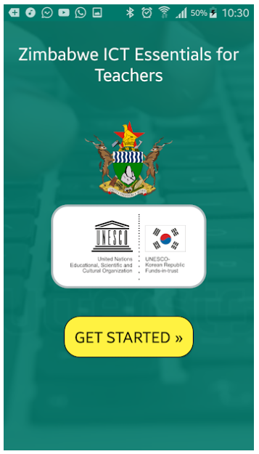
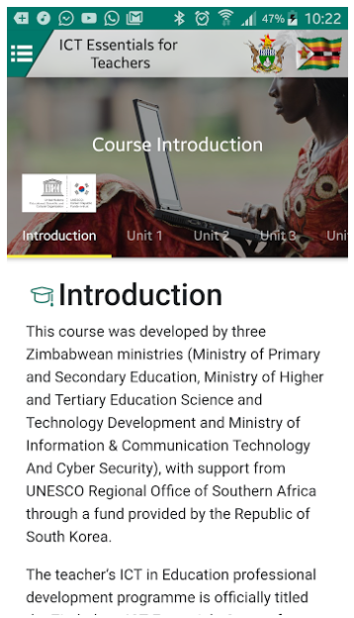
OER in Action │ UNESCO ICT CFT Courses Timeline
Zimbabwe (2017 - 2018)
Course name Zimbabwe ICT Essentials Course. Audience: In-service teachers Developers: Ministry of Primary and Secondary Education Methodology & distribution mechanism Facilitated – Offline course on USB stick Stand-alone – Google Play App
English
OER Commons
UNESCO ICT CFT Hub
Djibouti
Togo
Guyana
Rwanda
Kenya
Ratio of
ICT-CFT Approaches
South Africa
Zimbabwe
Creative Commons
licence
Zimbabwe ICT CFT - Android Apps on Google Play
Notes:
2017-2018 - Adaptation of the Rwanda materials by the Ministry of Primary and Secondary Education, to create the Zimbabwe ICT Essentials Course. The materials were contextualised and made available as an off-line course accessed from a USB stick. The course is a facilitated course where ICT literate teachers are trained to cascade the course content and skills to their peers.

Slide 12

OER in Action │ UNESCO ICT CFT Courses Timeline
Egypt (2017 - 2018)
Course name: Egyptian ICT CFT Audience: Pre-service and in-service teachers Developers: American University of Cairo Methodology & distribution mechanism: Blended
Arabic
OER Commons
UNESCO ICT CFT Hub
Egypt
Djibouti
Togo
Guyana
Rwanda
Kenya
Ratio of
ICT-CFT Approaches
South Africa
Zimbabwe
Creative Commons
licence

Slide 13

OER in Action │ UNESCO ICT CFT Courses Timeline
Mozambique (2017 - 2018)
Course name: TIC na Pedagogica Audience: Pre-service and in-service teachers Developers: Institute of Open and Distance Education (IEDA) Methodology & distribution mechanism: Blended
Portuguese
OER Commons
UNESCO ICT CFT Hub
Egypt
Djibouti
Togo
Guyana
Rwanda
Kenya
Mozambique
Ratio of
ICT-CFT Approaches
South Africa
Zimbabwe
Creative Commons
licence
TBD

Slide 14

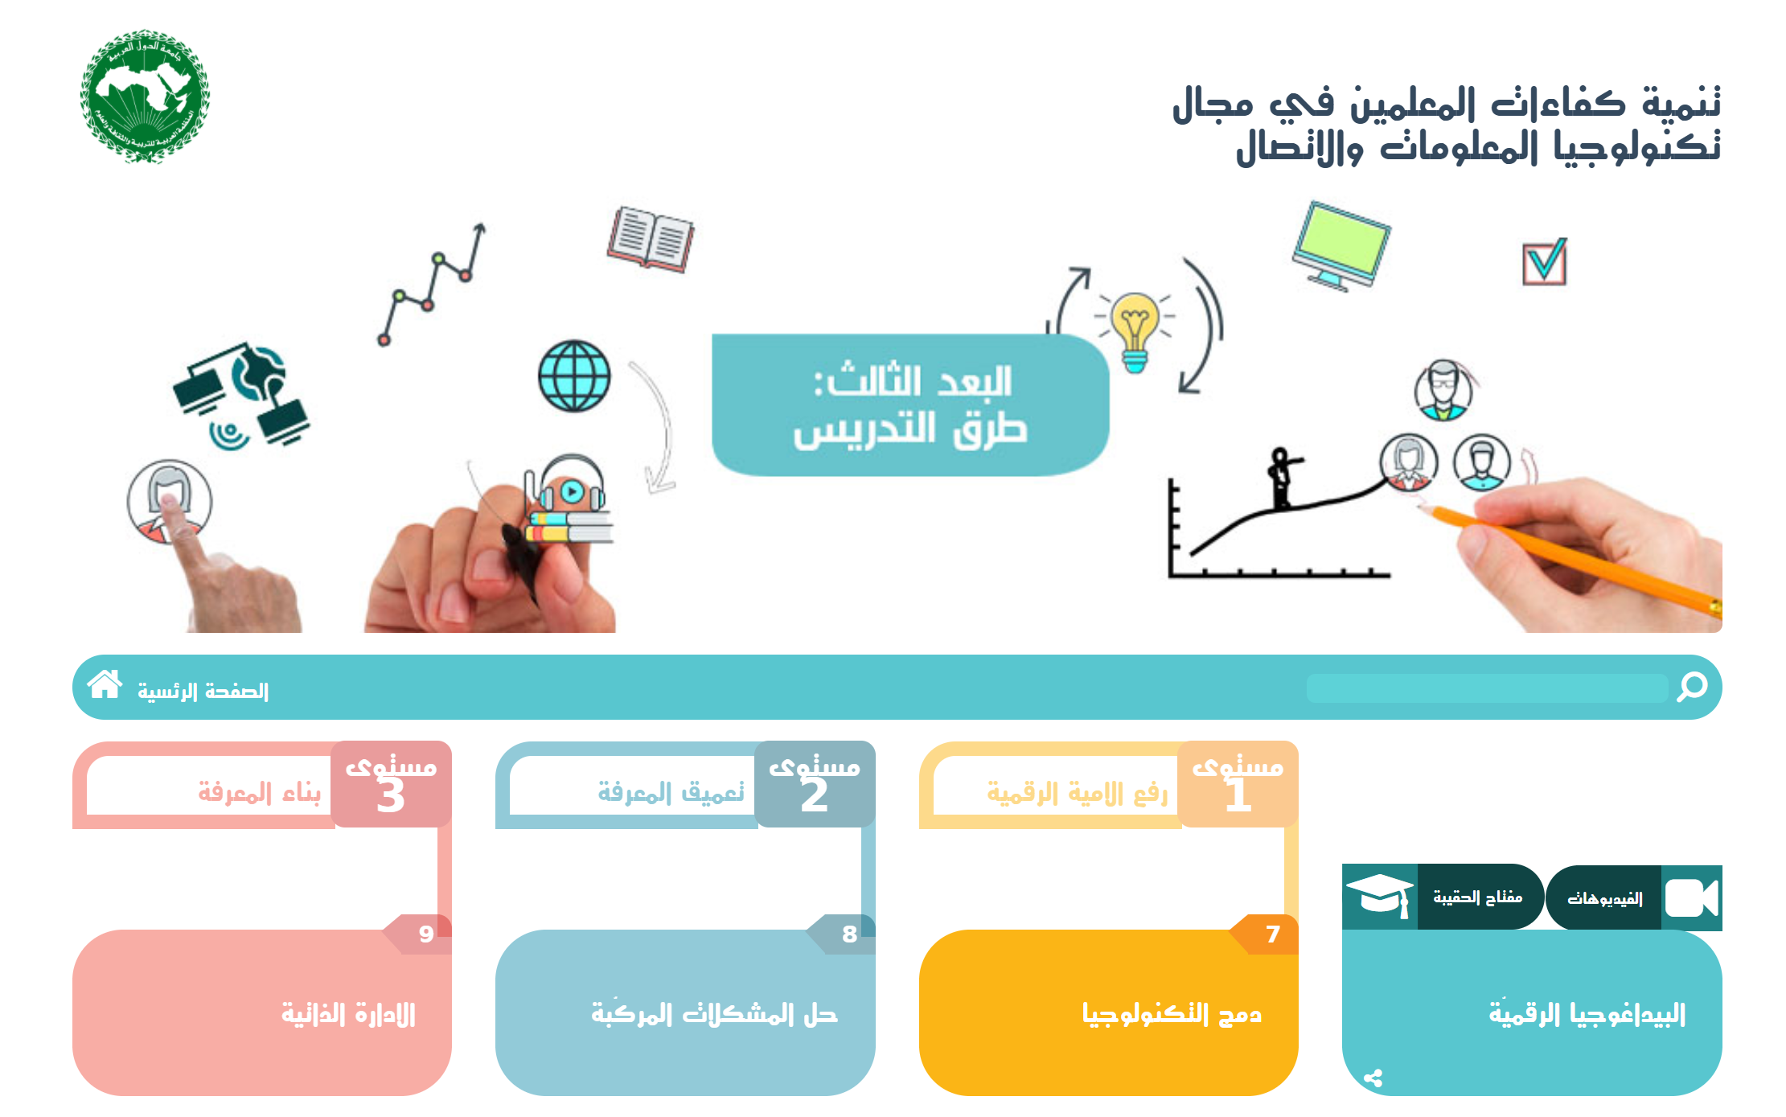
OER in Action │ UNESCO ICT CFT Courses Timeline
ALECSO / Tunisia (2018 - 2019)
Course name: Understanding ICT in Education فهم تكنولوجيا المعلومات والاتصالات في التعليم Audience: Pre-service and in-service teachers Developers: ALECSO Methodology & distribution mechanism: Blended
Arabic
OER Commons
UNESCO ICT CFT Hub
ALECSO
Egypt
Djibouti
Togo
Guyana
Rwanda
Kenya
Mozambique
Ratio of
ICT-CFT Approaches
South Africa
Zimbabwe
Creative Commons
licence
TBD

Slide 15

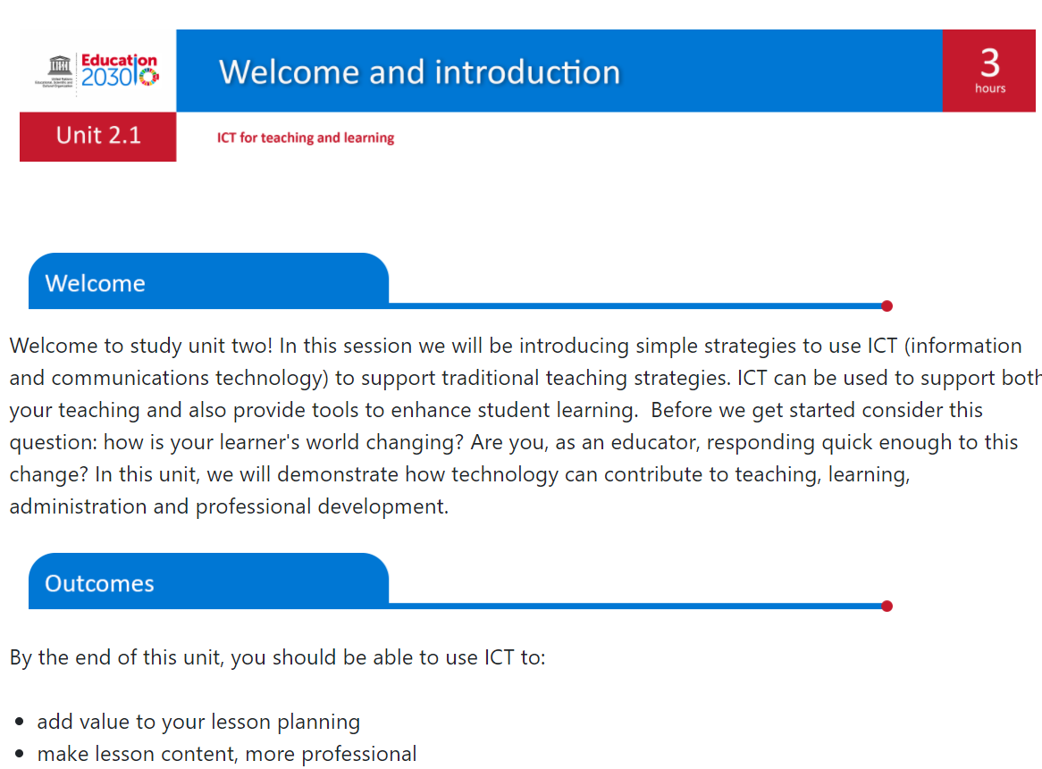
OER in Action │ UNESCO ICT CFT Courses Timeline
UNESCO / Generic (2021)
Course name: ICT CFT Course (Generic) Audience: Pre-service and in-service teachers Developers: UNESCO Methodology & distribution mechanism: Online (Moodle) using ‘Competencies’ Paper-based materials
English
UNESCO
OER Commons
UNESCO ICT CFT Hub
ALECSO
Egypt
Djibouti
Togo
Guyana
Rwanda
Kenya
Mozambique
Ratio of
ICT-CFT Approaches
South Africa
Zimbabwe
Creative Commons
licence
TBD

Slide 16
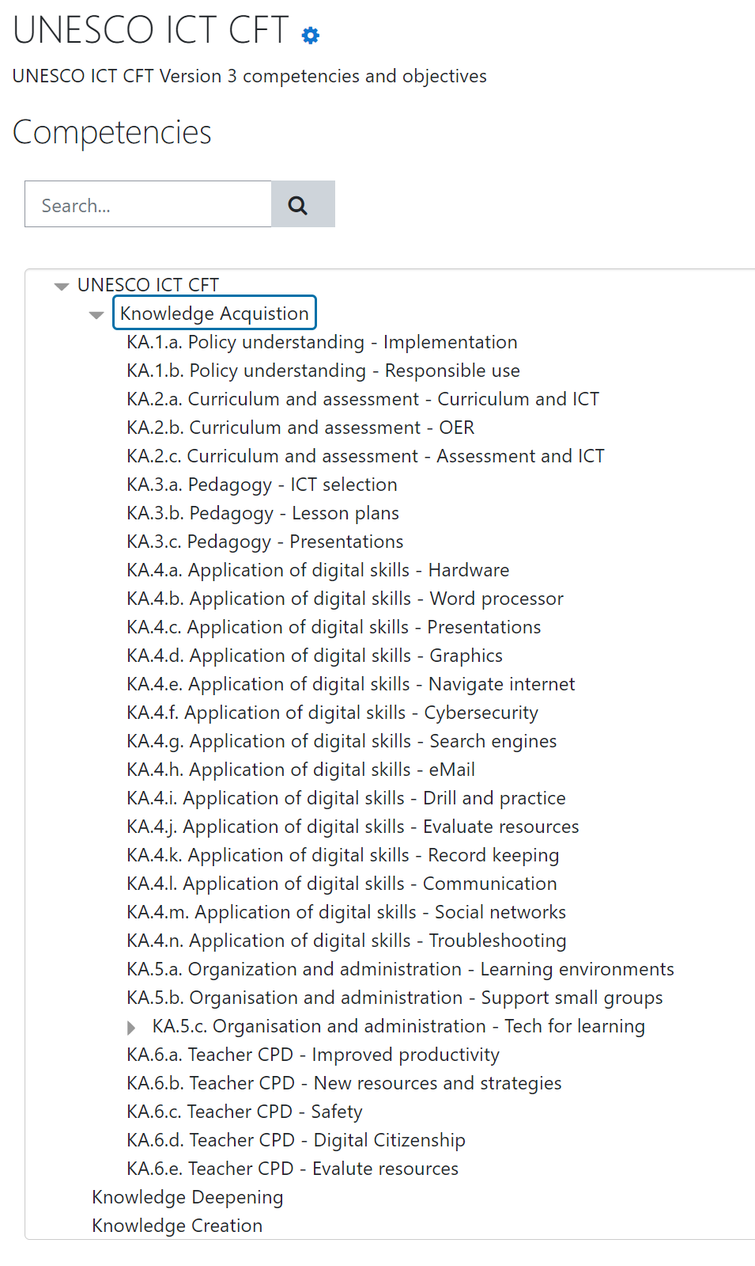

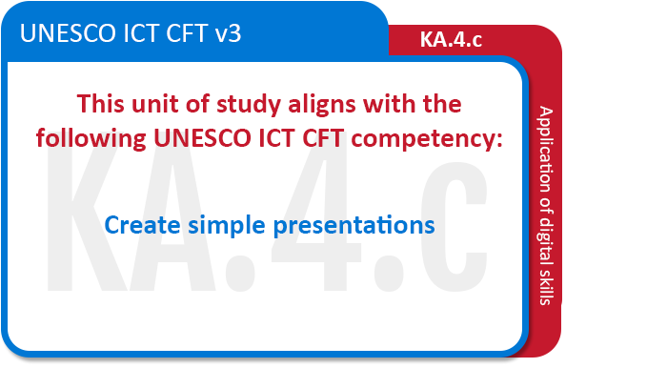

Slide 17


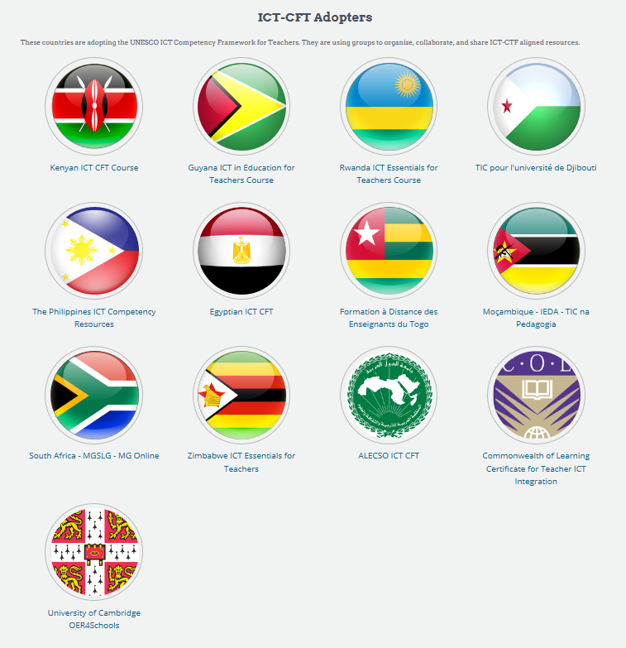
Network of experience
Framework to identify scope
Free, quality adaptable resources

Slide 18
ICT CFT | OER | CoP
Access the Framework
The UNESC ICT Competency Framework for Teachers:
https://unesdoc.unesco.org/ark:/48223/pf0000265721

Slide 19
ICT CFT | OER | CoP
Access the Resource Hub
Conclusion
The UNESCO ICT CFT Resource Hub on OER Commons
https://www.oercommons.org/hubs/UNESCO
Leveraging advantage from existing OER in the creation of teacher professional development courses
Prepared by Neil Butcher & Associates

Slide 20
ICT CFT | OER | CoP
Access the Network of Champions
The UNESCO ICT CFT Resource Hub on OER Commons
https://chat.whatsapp.com/HSkN0gQLbZECV1TQdjoxMh

Slide 21
Thanks
Leveraging advantage from existing OER in the creation of teacher professional development courses
Prepared by Neil Butcher & Associates
Notes:
By adapting shared open resources that respond to a common framework nine countries have been able to build teacher professional development courses quickly and cost effectively.
UNESCO ICT CFT Courses are an example of open educational resources in action.

